Slide 1
Physical computing from Scratch using scratchClient – Beginners Control servos, LEDs and more from Scratch using RPi, Arduino, scratchClient
Hans de Jong & Gerhard Hepp
Workshop for the Pi And More and Maker Faire conferences

Slide 2
Part 1: Introduction

Slide 3
On-line videos
For on-line videos, look at Youtube and search for scratchClient Tutorials.
This presentation has been updated in some details, but you can still use it.
ScratchClient has two modes of representing the blocks:
Workshop mode: use name value pairs
Verbose mode: every input or output variable has its own block
In this workshop we use the workshop mode.
See appendix A how to get the other representation, which may be handier in certain cases.

Slide 4
Workshop organisation
The major steps:
Get a working hardware and scratchClient config using a scratchClient config tool.
Put components on the board and test out your setup.
Write some code in Scratch
Add more hardware and update the config file.
And repeat this.
Welcome and introduction presentation (5 min).
After that everyone will work at his or her own pace.
Choose with your “workplace partner” which topics you want to do.
There is more material than what can be covered in 110 minutes.
Language: English, German and Dutch
At the end copy the material you created to your USB stick (if you want)
Break down & clean up (5 min)

Slide 5
Objectives
At the end the workshop you should be able to do a few of these items:
Reproduce the setup at home (provided you have the hardware ☺ )
You can get all files via https://github.com/hansdejongehv/scratchClient-Tutorials
Or go to www.github.com and search for scratchClient
Understand (depending on how far you get and how deep you dive in)
Digital output (e.g. lighting a LED)
Digital input (e.g. sensing a button)
Analog input (e.g. from a potentiometer)
Pulse Width Modulation (PWM)
For dimming LEDs
For controlling servos
For sounding a buzzer
Understand what all the resistors are for
Be able to configure and run scratchClient
Program Scratch to control the physical input and output
Monitoring the inputs and outputs
Have fun!

Slide 6
Non-objective
It is not an objective to create a complete useful game or other program.
You can do that with your own creativity at home now that you know how to control several pieces of hardware from Scratch using scratchClient.

Slide 7
Example of what can be created with Scratch and scratchClient
https://www.youtube.com/watch?v=Qo1gnXNzhqE

Slide 8
Versions of Scratch
scratchClient can work with
Scratch 1.4
The (for Raspberry Pi) new Scratch 2
This workshop is written for Scratch 2
Scratch 2 on Raspberry Pi has some bugs, but we will work around it.
If you want to see how to do it for Scratch 1.4, see the end of the presentation in Appendix B.

Slide 9
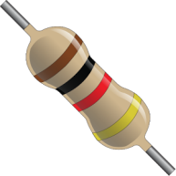
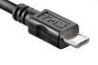
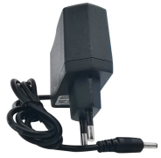
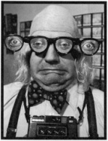
Only a few rules today
Always put a resistor in series with the components when indicated.
If you think there is no need then please tell us and we will explain what the reason is.
When changing the wiring
Detach the USB cable from the Arduino Nano
Detach the 9 volt connector
Check, double check and check again whether the wiring is correct. You may blow up components when wiring wrongly!
Make sure that you both (4 eyes principle) are convinced the wiring is OK before reconnecting and turning on power again.
After changing a config file: restart scratchClient
If something breaks down or gets damaged: we have some spare material
Do not put anything that is broken back into the box please.

Slide 10
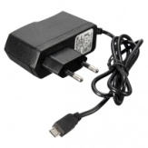
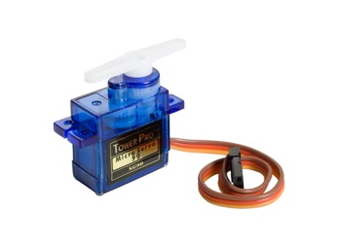
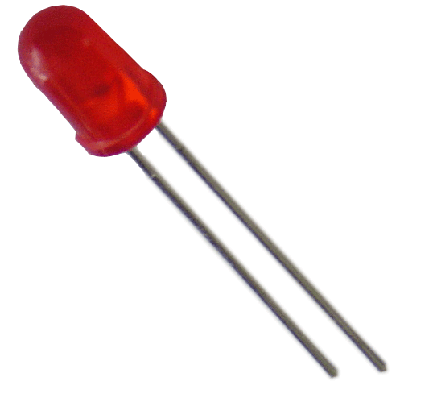
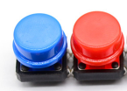
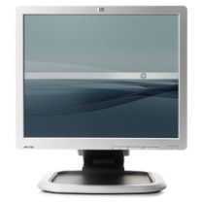

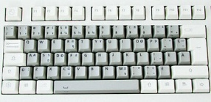
The setup
Raspberry Pi 2B or 3B
Arduino Nano
Scratch 2 run time
Scratch 2 extension for scratchClient
scratchClient
scratchClient Sketch
USB
Program written in Scratch
Predefined sprites (with some code, sounds and costumes)
scratchClient Config file
Defines function of the GPIO pins on the Arduino (and RPi) and gives them logical names.
Standard setup
Programmed by the students (today: you)
Prepared by the teacher or expert (today: you)

Slide 11
Often asked: why using an Arduino?
Question: why not just the GPIO pins of the Raspberry Pi?
Answer:
Arduino has analog in and has a hardware pulsewidth modulation (PWM) for more stable servo control.
Arduino uses 5 volt. Raspberry Pi GPIO pins are not 5 volt tolerant.
If children mess up with electronics, they potentially blow up an Arduino clone of 2 euro rather than a Raspberry Pi of 35 euro.
Keeping the setup transportable, now only one USB plug has to be connected, rather than otherwise a large pin header.

Slide 12
Choose what you want to do
Workshop is for everyone, from beginners to experts.
Not enough time to do all, so choose what you want to do.
Yellow slides have background information and you can skip them if you want or look at it later.
Recommended
All: learn to configure scratchClient by doing LEDs (digital out) and Button (digital in)
All: try it out in Scratch
After that: select further topics from separate files
Intermediate level
Advanced level
Expert level

Slide 13
Part 2: Getting to know the components

Slide 14
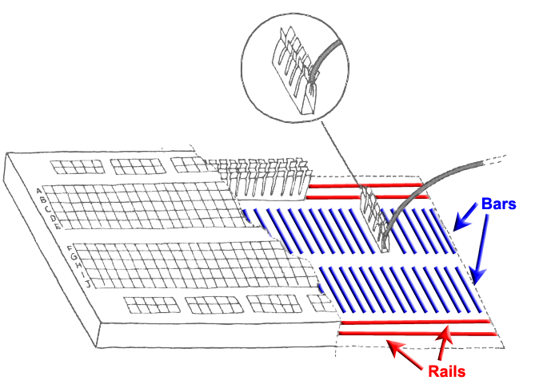
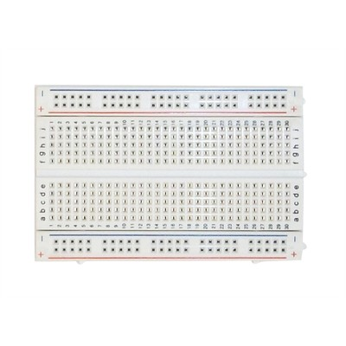
Breadboard
Used to quickly build electronic circuits
Note the 2 rails for + (VCC) and – (GND)
Note on every column (vertical) the 2 bars with 5 interconnected holes each.

Slide 15
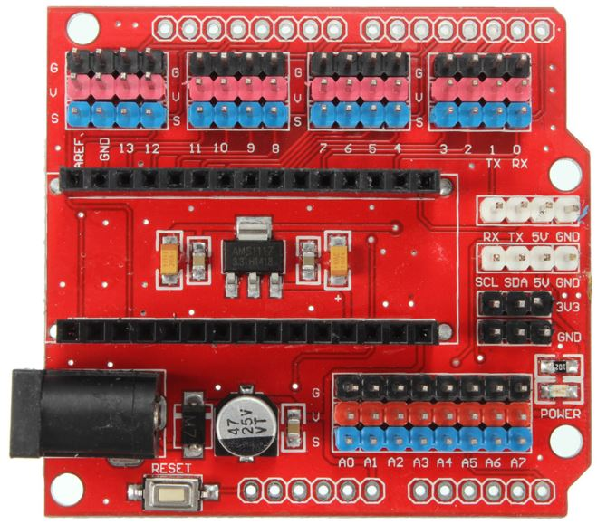
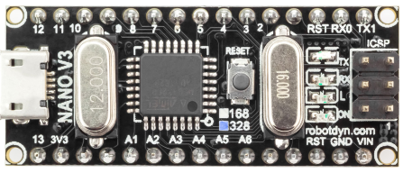
Looking at the Arduino Nano extension board
Analog ports (most can be used as digital ports as well)
Reset button
Per GPIO signal 3 headers:
S (blue = signal)
V (red = VCC = +)
G (black = GND = -)
(very handy to e.g.
connect servos)
9V power socket
Arduino Nano with 328P processor
Micro USB port
Reset button
Digital ports

Slide 16
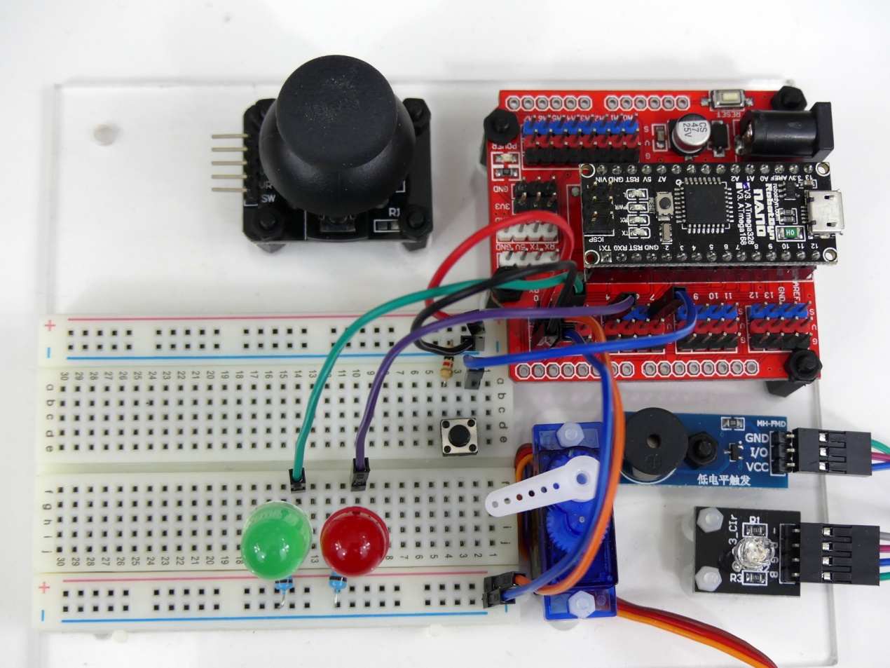
What the final board looks like …
… at the end of the beginners workshop

Slide 17
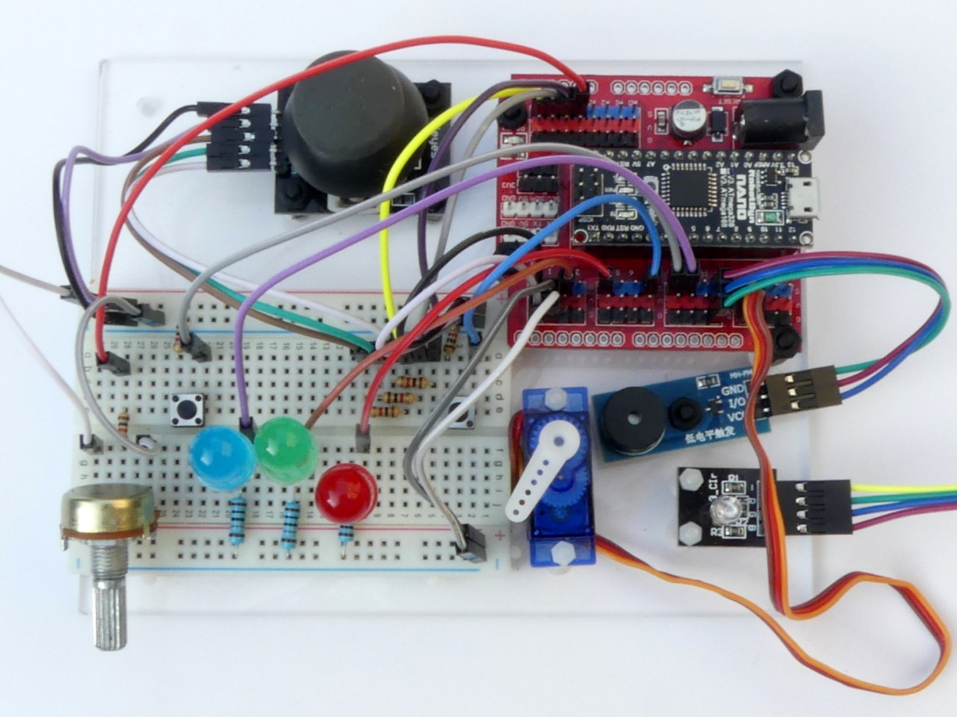
… at the end of the intermediate level …

Slide 18
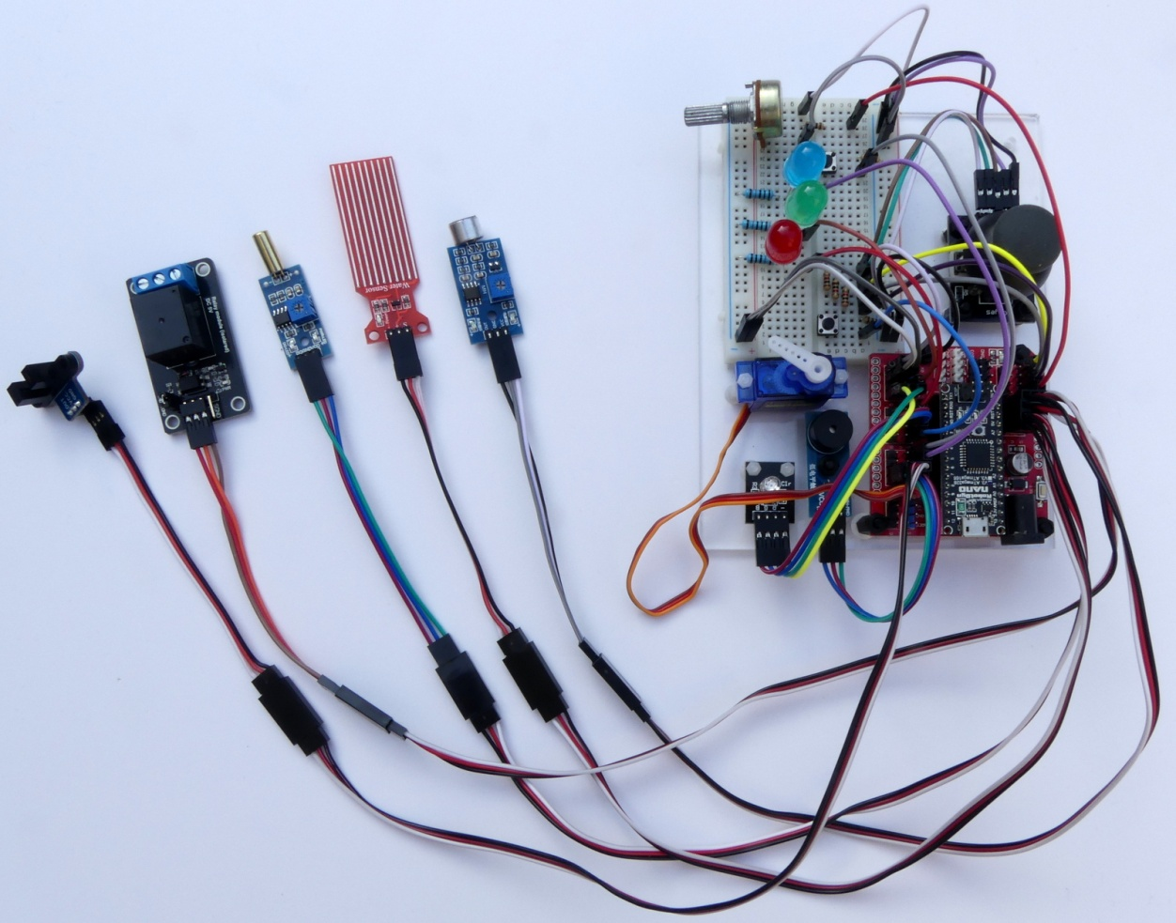
… and at the end of the advanced level

Slide 19
Part 3: Loading the sketch in the Arduino (in the workshop: optional, at home: mandatory)

Slide 20
Preparing for programming the Arduino Nano
The Arduino needs to run a program (in Arduino terms: sketch) so that it can communicate with the Raspberry Pi and understand the messages from scratchClient.
We need to start putting that in.
However in the workshop that has already been done, so you can skip the next slide, unless you want to try for yourself.
If you are doing this at home, then you will need to do it however.

Slide 21
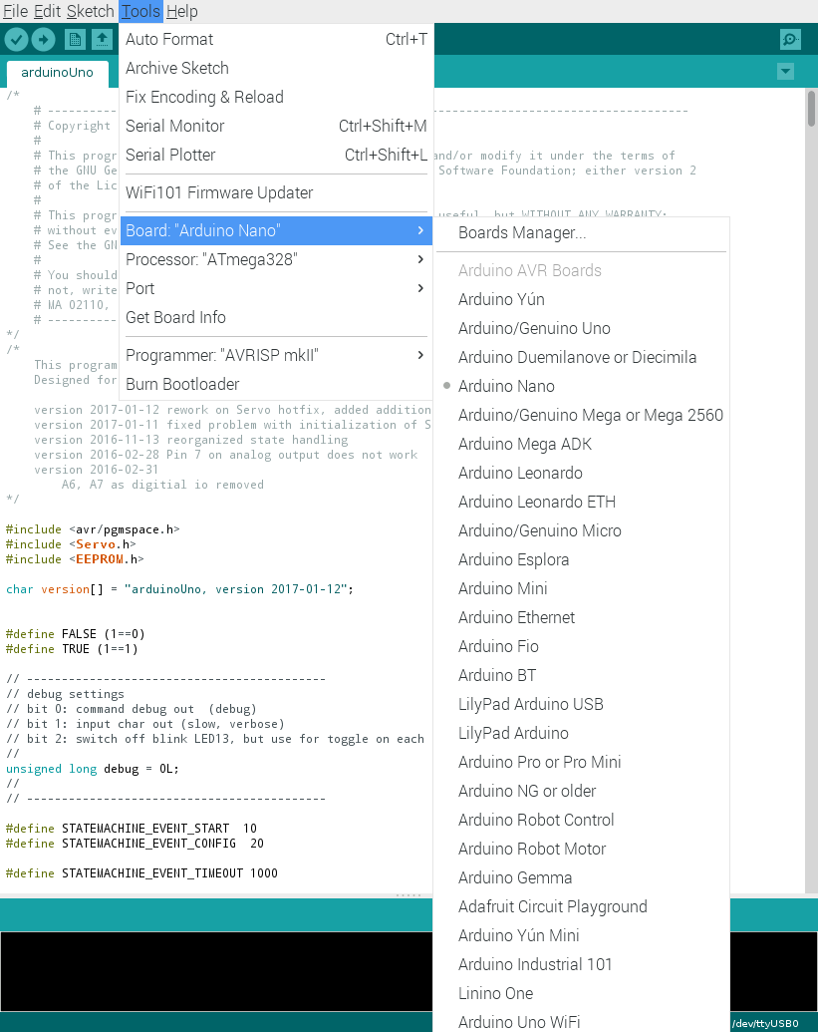
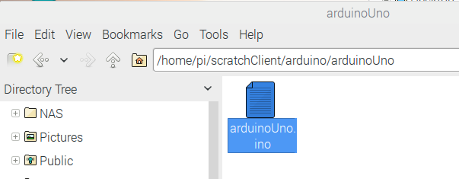
Uploading scratchClient to the Arduino
Navigate to the scratchClient sketch for Arduino Uno in /home/pi/scratchClient/arduino/arduinoUno
Double click to open the Arduino IDE
Click Tools and make sure that these are set:
Board: Arduino Nano
Processor Atmega328
Port: the port where the Arduino Nano is connected (normally /dev/ttyUSB0)
Click on the Upload button.
Wait till the completion of the Upload is reported (without errors).

Slide 22
Part 4: Defining the configuration
Give names to pins and define the purpose of the pin

Slide 23
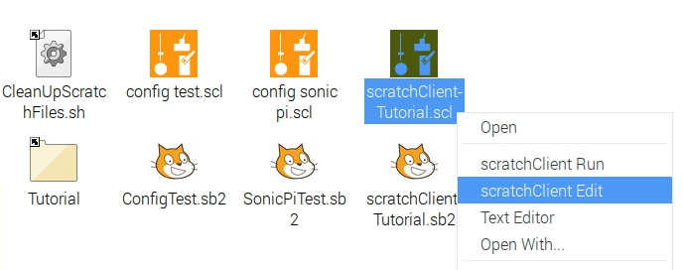
Starting the config tool
We have put an empty config file on the desktop:
scratchClient-Tutorial.scl
Right click the file and choose scratchClient Edit

Slide 24
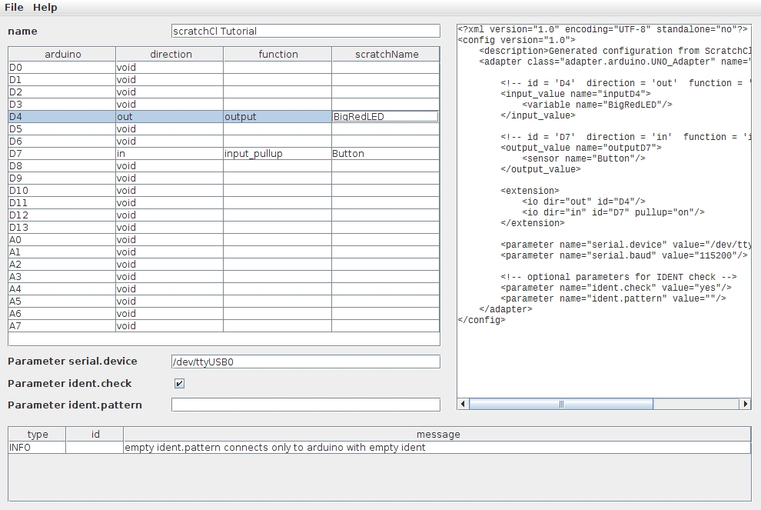
Define the first config file
D4
Direction: out
Function: output
scratchName: BigRedLED
Double click a cell to get a drop down menu
First for direction then for function.
Make sure to give all pins a name if you choose something else than void in direction.
So make sure not to save if you still have red borders around cells. scratchClient will fail to start with such a config file.
The tool checks wrong configurations. Examples:
Pins 0, 1 and 13 cannot be used at all
Analog In only available on A0 to A7
Pins A6 and A7 can only be used for Analog In
Pins 9 and 10 cannot be used for PWM if any pin is configured for servo (see later)
D7
Direction: in
Function: input_pullup
scratchName: Button
Parameter serial.device: /dev/ttyUSB0

Slide 25
Save the config file
Save the file (ctrl-S or File → Save).
Warning: closing the file without saving will loose all changes.
Leave the tool open for the next exercises.

Slide 26
Part 5: Wiring the board and run the first setup

Slide 27
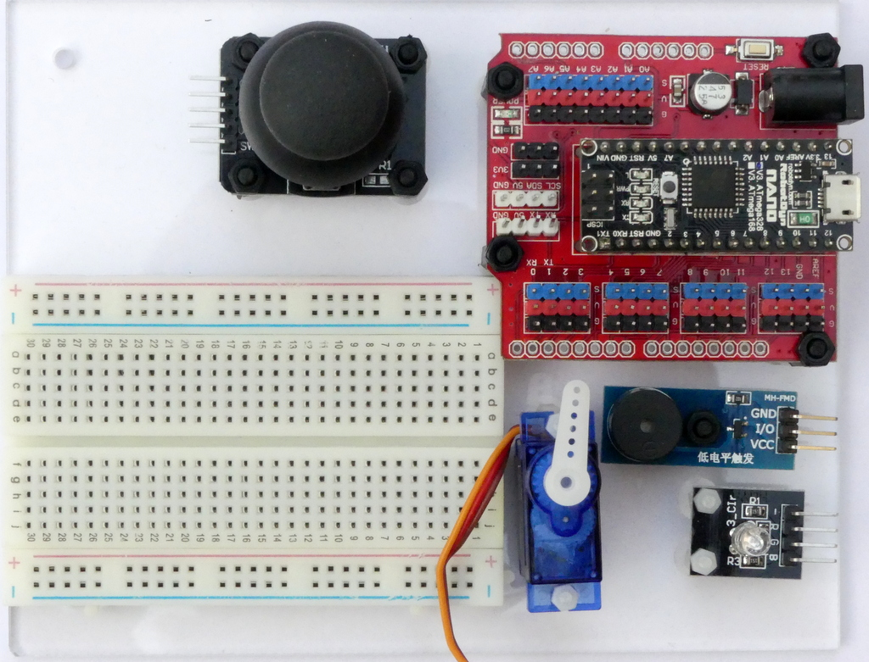
Put the board in front of you in this way

Slide 28
Use short wires and use the indicated holes
There are some short wires (10 cm) and some longer (15 cm)
Use the shortest that you can
Get a less messy setup
You may otherwise run out of long wires later
Ignore wire colors.
You can in principle build up at different places on the breadboard, however …
… please use the indicated columns to avoid running out of space on the breadboard in the later part of the workshop.

Slide 29
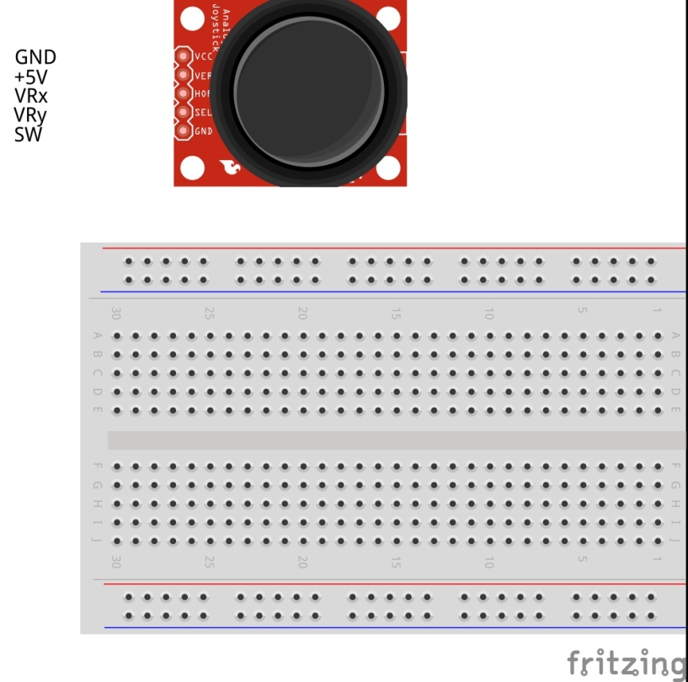
Connect the power wires

Slide 30
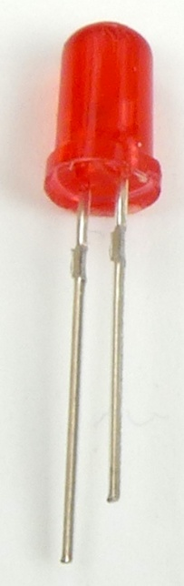
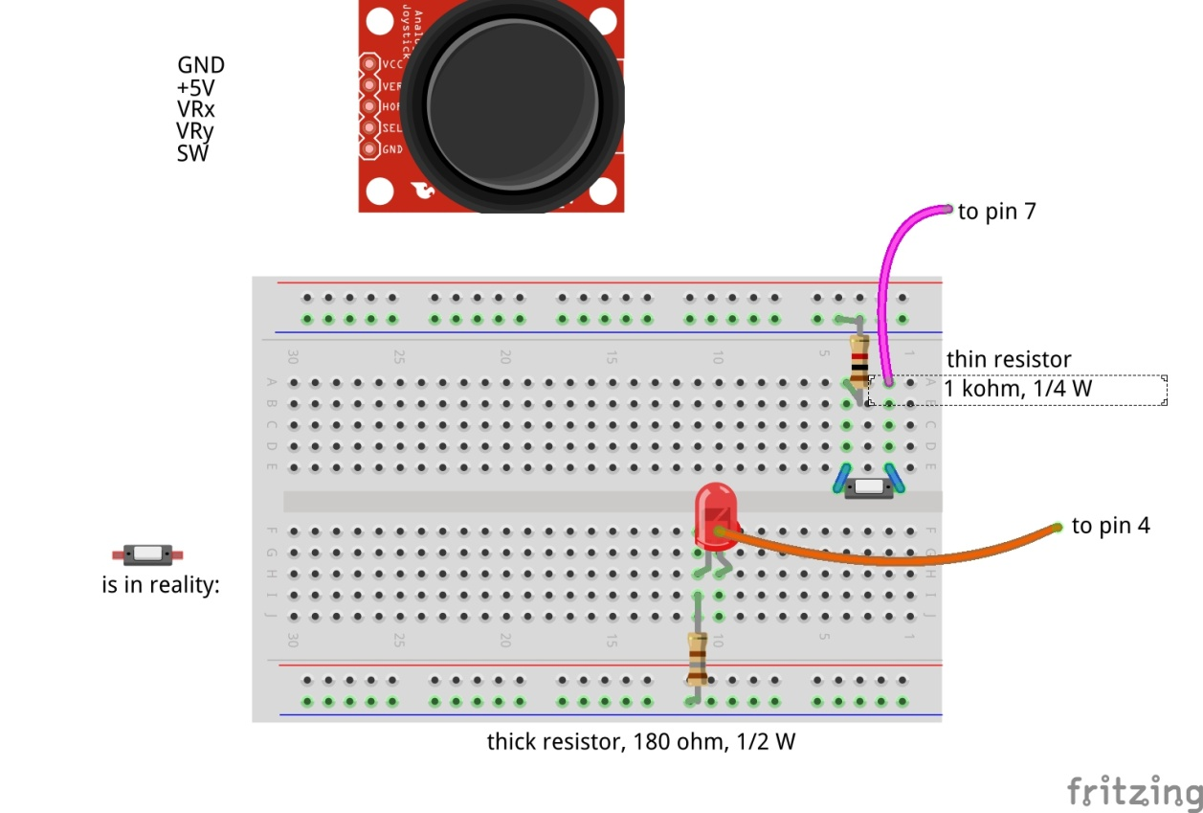
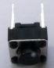
Insert the red LED and button
Long wire = plus (+) side
Short wire = minus (-) side
Notes:
The LED has polarity. The long wire is the + side, the short wire is minus. You must connect LEDs such that the minus side of the LED is closest to the minus on the board and the plus side is of the LED is closest to the plus on the board – which is for this LED provided by the Arduino pin.

Slide 31
Why putting a resistor in series with the LED?
+5 volt
Arduino
Digital output
The LED
This resistor is for limiting the current through the LED
(you will blow up the LED and/or the Arduino otherwise)
+
-
180 Ohm resistor (the thick ones in the box)
0 volt

Slide 32
What does Arduino need on a Digital Input pin?
A digital input pin of Arduino needs to get either
0 volt input (actually, 0 to 1.5 volt is considered a LOW input signal)
5 volt input (actually, 2.5 volt to 5 volt is considered a HIGH input signal)
If it gets something between 1.5 volt and 2.5 volt, the interpretation will not be stable (could be LOW or HIGH).
If it does not get any signal in, then the interpretation of the signal is not stable (could be LOW or HIGH).

Slide 33
Producing a LOW value
+5 volt
Arduino
Digital input
The button
If the button is closed, the digital input signal is set to 0 volt which is detected as LOW.
0 volt
But what will the Arduino detect if the button is open?
33

Slide 34
Producing a HIGH value
+5 volt
If the button is pressed, then it connects the input of the Arduino to 0 volt. There will run a small current through the resistor, but the input will be 0 volt.
If the button is open, the resistor will pull up the input to 5 volt. A very small current will flow through the resistor and through the Digital In unit in the chip, but is small enough that the voltage on the digital input will be very close to 5 volt = HIGH.
Arduino
30
kOhm
This is a pull-up resistor that provides 5 volt if the button is opened
Digital input
0 volt
34

Slide 35
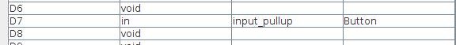
Producing a HIGH value without external resistor
+5 volt
Arduino
You do however not have to connect the resistor externally. It can be configured in the Arduino itself by specifying input_pullup rather than input.
Digital input
0 volt
35

Slide 36
Danger when misconfiguring
+5 volt
Arduino
This works fine for input, but what happens if you misconfigure the pin to be Digital Output, set the value to HIGH and press the button?
If the Arduino makes the pin HIGH (5 volt) and the button connects to LOW (0 volt) → short circuit and the Arduino will be blown up.
Digital output
0 volt
36

Slide 37
Resistor in series with the switch would prevent damage
+5 volt
Arduino
If now the pin is made HIGH and the button is pressed there will run a small current of 5 volt / 1 kOhm = 5 milliAmpere which is well below the max of 20 mA.
Digital output
1 kOhm
0 volt
37

Slide 38
When port is correctly configured as Digital In, the resistor in series is OK
+5 volt
Therefore always include a 1 kOhm resistor in series with the switch.
When the switched is closed there will run a small current through the resistors. Therefore, the input will be 1 kOhm / (30 kOhm + 1 kOhm) * 5 volt = 0,15 volt.
Arduino
Digital input
1 kOhm
0 volt
38

Slide 39
Check / double check
Please now check both of you that the wiring is correct.

Slide 40
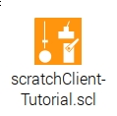
Bringing things together
Connect the 9 volt connector to the board and switch power on
Although as long as you are only having a LED that is used, the power supplied via USB is sufficient
Connect the USB connector to the Arduino
Doubleclick scratchClient Tutorial.scl on the desktop to start scratchClient with the config file you have just updated
It will also open a browser window where you can see variables
Explained later in the presentation
In the terminal window you will see complaints that scratchClient has no connection to Scratch
Which is logical because Scratch was not started yet.

Slide 41
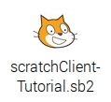
Start Scratch 2
Simplest is to start the file on the desktop
Doubleclick the icon
See the appendix how make such a file yourself
There are some anomalies to deal with in the current release of Scratch 2

Slide 42
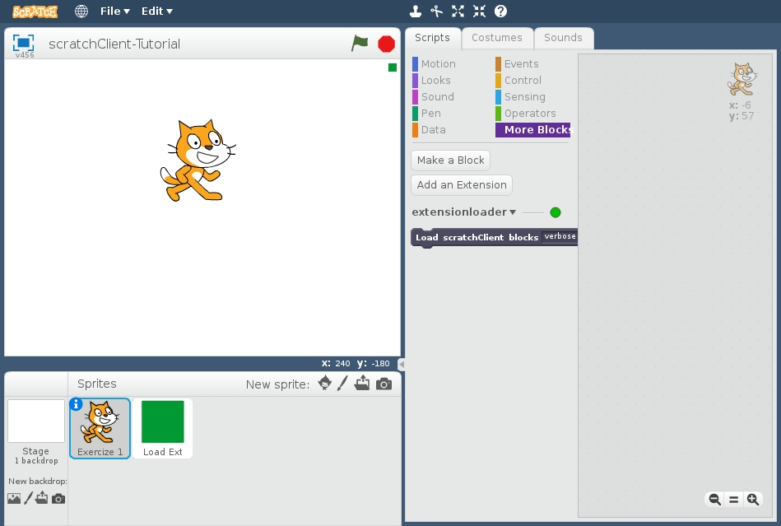
Click on this sprite to make the extension blocks visible.
You need to do this every time that you open the Scratch project.

Slide 43
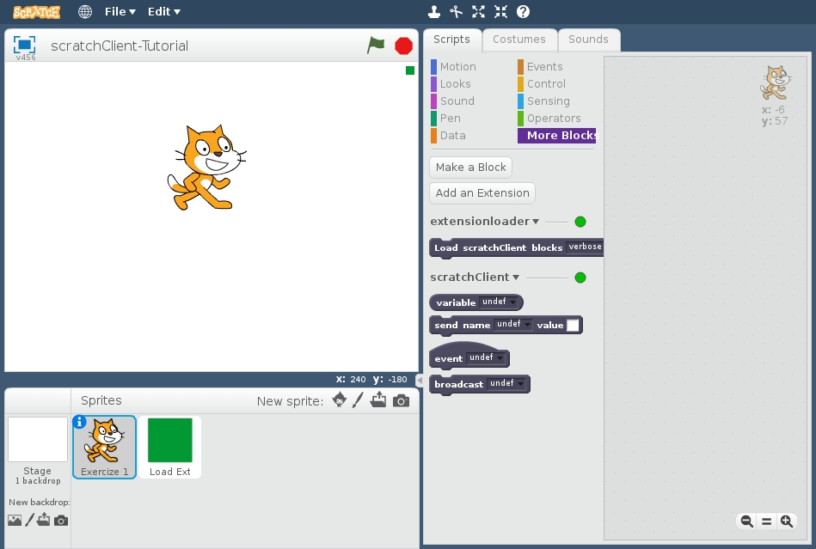
Clicking on the green sprite caused the extra blocks to appear

Slide 44
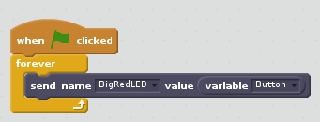
Create the Scratch program
Create this program in Scratch (put it in the screen or the Cat sprite)
Try it out (click the set of blocks or click the green flag above the animation window).
Digital in (Button):
0 = pressed
1 = not pressed
Digital out (LED)
0 = off
1 = on
Analyse how the program works.
Use these arrows to select the correct value (the black on grey background is not so easily visible)

Slide 45
Does it work? (see next slide for help)
If the LED on the Arduino is blinking slowly only then the config is downloaded and only then scratchClient works.
It may take 10 seconds after both scratchClient and the scratchClient extensions in Scratch 2 are loaded before this happens.
So 10 seconds after you clicked on the green sprite.

Slide 46
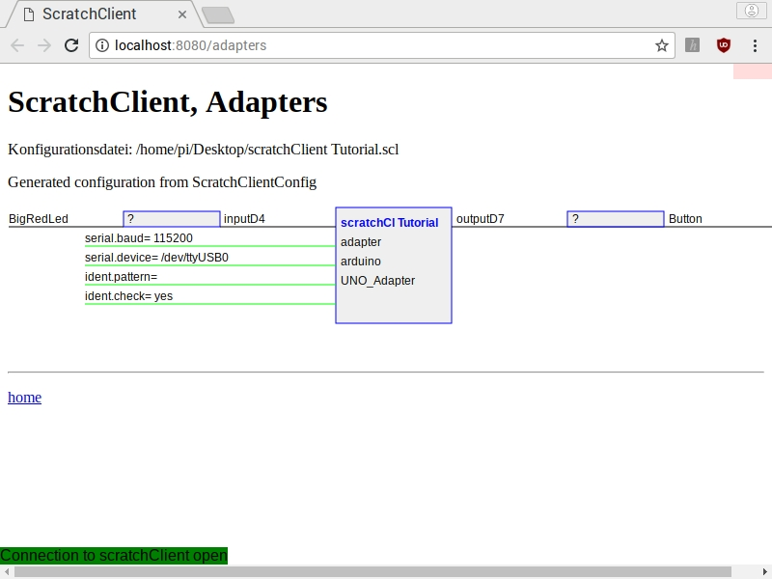
You can monitor the values that are exchanged
Together with scratchClient, the browser is opened with URL localhost:8080/adapters
Note the input & output directions:
Output of an adapter is an input for Scratch.
Output of Scratch is an input for the adapters.
Hence the names input and output look to be reversed from what is in the config file.
Therefore best refer to the variable names.
You will see that values are only displayed after they have changed (otherwise a question mark (?) is displayed).
Not for now, but you can click the field and type a value which then will be sent in the appropriate direction.

Slide 47
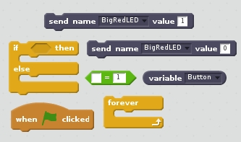
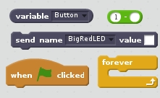
Change the program
Make a change in the program so that the LED goes on when the button is pressed.
There are (at least) two ways
You need the blocks depicted here
Blocks for method 1
Blocks for method 2

Slide 48
What if it does not work?
Check whether you have multiple Scratch instances open
scratchClient can only work with one Scratch instance at a time (regardless of being Scratch 1.4 or Scratch 2).
Check if the blue LED on the Arduino Nano is blinking slowly.
Sometimes, especially after reboot, if everything seems fine, disconnecting and reconnecting the Arduino Nano may help.
Try monitoring the variables, see before.

Slide 49
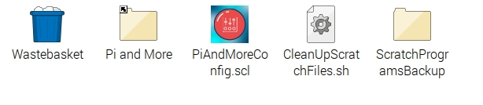
One reminder …
Save your Scratch program regularly. Otherwise it will be lost on power out.
Power out can easily happen since you are pulling cables and this may impact the power connector in the Raspberry Pi.
Here come some current Scratch 2 anomalies on Raspberry Pi
You should not use spaces in filenames (if you do, Scratch 2 cannot find the file when double clicked)
Scratch 2 forgets the folder where the file was opened from (Desktop). Just save it in /home/pi as Scratch proposes
Scratch 2 will save it with a .sbx extension regardless what you specify.
Hence once after initial power up
On the desktop, doubleclick CleanUpScratchFiles.sh
It will propose to automatically run from crontab. Recommended. This is the case in the workshop.
This will permanently monitor the folder /home/pi, and
Move all files with .sbx and .sb2 to the desktop as .sb2 files
Any spaces in filenames are removed
If there is already such a file on the desktop, it will be moved to the folder ScratchProgramsBackup on the desktop
It will also warn if you did not save the file for a while, when two Scratch instances are open, if scratchClient is not running and more.
If you reopen a saved file, click the green sprite once again to load the extension blocks

Slide 50
Part 6: Adding the Big Green LED

Slide 51

Adding the green LED

Slide 52
Check and reconnect
Check the correct wiring
Switch on the 9V power
Connect the USB cable again

Slide 53
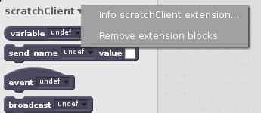
Update the config file and restart scratchClient
Use the config tool (which should still be open)
Define an output (direction: out, function: output) on pin 2 and call it BigGreenLED
Save the config file (and leave the tool still open)
Doubleclick scratchClient Tutorial.scl on the desktop again
This will stop the previous instance of scratchClient and restart with the updated configuration.
Remove the extension block.
Right click here
Choose Remove extension blocks
Add the extension block again by clicking the green sprite.
You will see in the More Blocks section that you can also now choose to send values to BigGreenLED

Slide 54
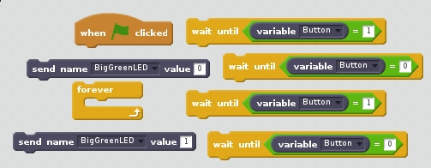
Update Scratch
Add code that does this:
Press button: LED goes on
Press once more: LED goes off
You need these blocks.

Slide 55
This is the end of the beginners tutorial
You got digital out (LED) and digital in (a button) working
You know how to work with scratchClient and Scratch 2
You know how to configure scratchClient
If you want and have time you can
Look at some of the yellow slides if you skipped them earlier
Continue with one of the next levels
These are in different files.
Otherwise,
Copy the material to a USB stick if you want to save it (see below how).
Pull all components from the breadboard and put them in the box.

Slide 56
Overview of next levels
Intermediate level
Analog In: Potentiometer
Pulse Width Modulation (in the absence of analog out)
Dimming a LED
Controlling a servo
Controlling a buzzer
Advanced level
Expert level

Slide 57
Part 10: Take your work home

Slide 58
Do you want to take your work home?
If you brought your own USB stick, then connect it and copy the scratchClient -Tutorial.scl file on the desktop, plus all .sb2 files that you created on the desktop
The rest of the material you can download from www.github.com, search for scratchClient-Tutorial
Take the flyer or business card with you to remember where to find the material on github.

Slide 59
Part 11: Summary & take aways

Slide 60
Takeaways of the beginners workshop
With scratchClient you define:
Function of each pin
Symbolic name for each configured pin
scratchClient config is the tool to setup the configuration
Restart scratchClient after you changed the configuration
Put a resistor in series with LEDs
Put a resistor in series with switches
Configure a pull up resistor if the input signal goes between 0 volt and being open rather than between 0 volt and 3 to 5 volt.
In Scratch 2, you use the extension block for scratchClient to get blocks that you can use to interact with scratchClient
You can monitor the value of all pins from the browser
scratchClient can do much more…
There are some anomalies, therefore
Save the Scratch 2 files in the home folder (as Scratch 2 proposes)
Run CleanUpScratchFiles.sh on the desktop (once after first start up of the RPi) and then let it automatically run from crontab as proposed.
Open the files from the desktop
Functions that a pin on Arduino can have:
Digital In
Digital Out
Analog In *
No Analog Out
Pulse Width Modulation as alternative *
For modulating the brightness of a LED
For controlling a servo
For controlling a buzzer
There a few more, see the advanced level tutorial
You can configure pull up resistors on Digital In
* See the intermediate level tutorial

Slide 61
Part 12: Clean up / teardown

Slide 62
If your scratchClient day ends here …
Unplug the board from USB and power it off
Please remove all components and wires from the breadboard
Remove all wires from the Arduino board.
Leave the wires on the 3 color LED (you did not use that)
Leave the wires on the buzzer
If something is broken, please
Throw it away or hand it in (if it is unclear)
Put a note in the box that it is missing
Do not put anything that is broken back in the box
Shutdown the Raspberry Pi
Let us know what you thought about this workshop, now orally or later by email
hans.piam@hanselma.nl
heppg@web.de

Slide 63
Appendix A Extension blocks in Scratch 2

Slide 64
How to add extension blocks in an empty Scratch file
Because of some anomalies, the loading of extension blocks is somewhat tricky.
You can use the way explained earlier.
This appendix explains how to create this from scratch.
Step 1: Make sure that scratchClient is running.

Slide 65
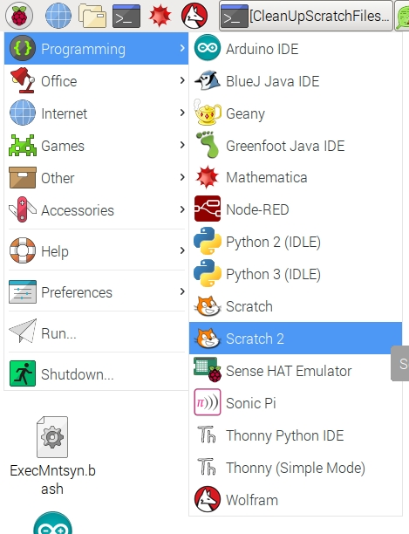
Step 2: Start Scratch 2

Slide 66
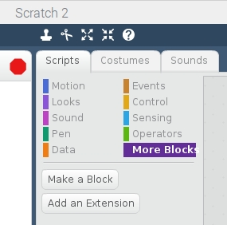
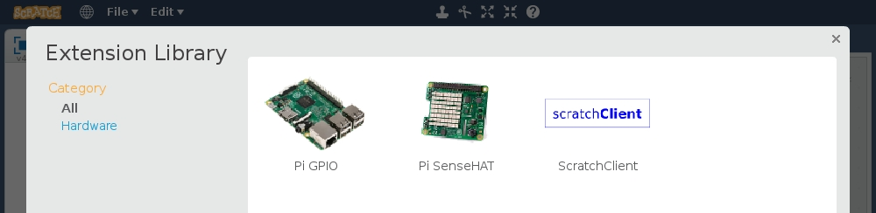
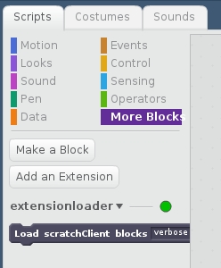
Step 3: Get scratchClient blocks (1 of 2)
Click on More Blocks
Click on Add an Extension
Choose scratchClient
Now a loader for the extra blocks of scratchClient get included.
However we now need to load the real blocks …

Slide 67
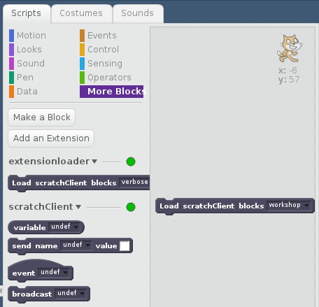
Step 4-7: Get scratchClient blocks (2 of 2)
Step 4: Drag this block to the Scripts area
Step 5: Choose here workshop
Step 6: Click the block so that the extra blocks will appear.
Step 7: See the blocks appear

Slide 68
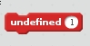
Saving will loose the blocks
If you reopen the file after it was saved,
The scratchClient extension loader will have been preserved
The real blocks have disappared
And you will see many blocks like this
Hence after opening you need to do steps 4 – 7 again.
Alternatively, see next slide.

Slide 69
Alternative for steps 4 – 7
Instead of doing steps 4 – 7 manually every time the file is loaded you can:
Include a sprite called Load Name-Value Extension Blocks.sprite2 from the folder ~/scratchClient-Tutorials/scratchClientExtension/Sprites
Note that when you try to load a sprite, the mouse buttons becomes unresponsive.
Use the keyboard instead to navigate
Left arrow, right arrow to move between columns
Up arrow, down arrow to move through the items in the column
Return/enter to select
Esc key will get you out of this mode
That sprite has a small green square that you can click to get the extra blocks loaded every time that you reopen a file

Slide 70
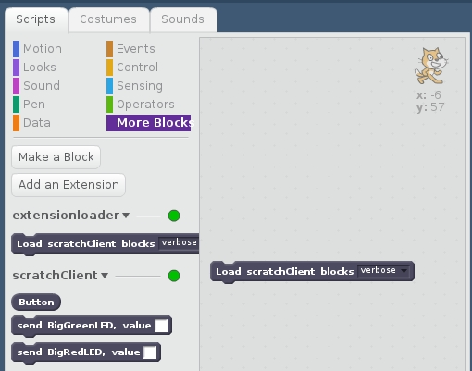
Another representation of blocks
scratchClient blocks can also be represented with one block per input or output value
You would then get e.g.
A separate block for BigRedLED
A separate block for BigGreenLED
A separate block for each input variable (here only Button)
You can get this representation by selecting verbose on the loader block

Slide 71
Easily get the verbose version of the blocks
Include a sprite called Load Verbose Extension Blocks.sprite2 from the folder ~/scratchClient-Tutorials/scratchClientExtension/Sprites
That sprite has a small green circle that you can click to get the extra blocks loaded every time that you reopen a file.
Contrast that with the loading of name value pairs for which you use the other sprite that has a small green rectangle.

Slide 72
Appendix B When using Scratch 1.4

Slide 73
The setup
Raspberry Pi
2B or 3B
Arduino Nano
Scratch 1.4 run time
scratchClient
scratchClient Sketch
Remote Sensor Protocol Over socket 42001
Global variables
Broadcasts
Program in Scratch
Predefined sprites (with some code, sounds and costumes)
scratchClient Config file
Defines function of the GPIO pins on the Arduino (and RPi) and gives them logical names.
Standard setup
Programmed by the students
Prepared by the teacher or expert

Slide 74
Defining the config file
Nothing new, you can use the exact same config file for Scratch 1.4 as for Scratch 2.

Slide 75
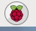
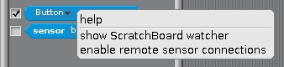
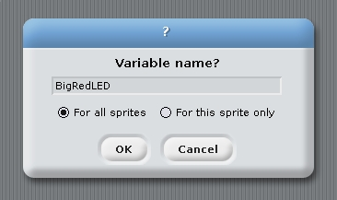
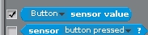
Create the Scratch program
Start Scratch → Programming → Scratch
Enable remote connections (right click on sensor value)
Create the variable BigRedLED, available to all sprites
Make the variable visible (tick the box in front)
Make the Button sensor visible
Save the file on the desktop.

Slide 76
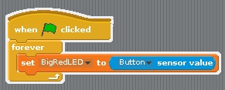
Program in Scratch 1.4
Make this program in scratch which will let the Red LED lite up when the button is released.
Test whether it works.

Slide 77
Further …
You can now look at the Scratch 2 material earlier in the presentation.
Try out adding the BigGreenLED and the same blocks to process it.

Slide 78
Appendix C Basic Electronics

Slide 79
To be added

Slide 80
Appendix D More Information

Slide 81
More information
All workshop material
www.github.com and search for scratchClient Tutorials
scratchClient
http://heppg.de/ikg/wordpress/?page_id=6
Scratch
https://scratch.mit.edu/
Scratch on Raspberry Pi
https://www.raspberrypi.org/forums/viewforum.php?f=77
Raspberry Pi
https://www.raspberrypi.org/
Arduino
https://www.arduino.cc/

Slide 82
End of the beginners workshop

